Slide 1
ANDROID – FRAGMENTS

Slide 2
Fragment
An activity is a container for views
When you have a larger screen device than a phone –like a tablet it can look too simple to use phone interface here.

Slide 3
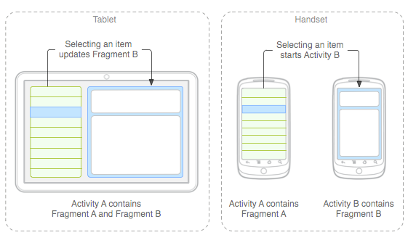
Fragment Idea
→ Fragments
    Mini-activities, each with its own set of views
    One or more fragments can be embedded in an Activity
    You can do this dynamically as a function of the device type (tablet or not) or orientation
You might
decide to run
a tablet in
portrait mode
with the handset
model of only
one fragment
in an Activity

Slide 4
Fragment
A Fragment represents a behavior or a portion of user interface in an Activity.
You can combine multiple fragments in a single activity to build a multi-pane UI and reuse a fragment in multiple activities.
You can think of a fragment as a modular section of an activity, which has its own lifecycle, receives its own input events, and which you can add or remove while the activity is running (sort of like a "sub activity" that you can reuse in different activities).

Slide 5
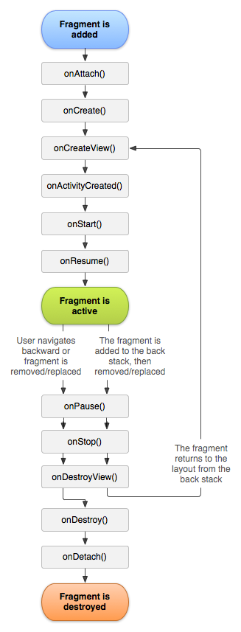
Fragment Lifecycle
Fragment in an Activity---Activity Lifecyle influences
  Activity paused → all its fragments paused
  Activity destroyed → all its fragments paused
  Activity running → manipulate each fragment independently.
Fragment transaction →add, remove, etc.
  adds it to a back stack that's managed by the activity—each back stack entry in the activity is a record of the fragment transaction that occurred.
  The back stack allows the user to reverse a fragment transaction (navigate backwards), by pressing the Back button.

Slide 6
Fragment inside Activity
it lives in a ViewGroup inside the activity's view hierarchy
fragment has its own view layout.
via XML: Insert a fragment into your activity layout by declaring the fragment in the activity's layout file, as a <fragment> element,
via CODE: from your application code by adding it to an existing ViewGroup.
you may also use a fragment without its own UI as an invisible worker for the activity.

Slide 7
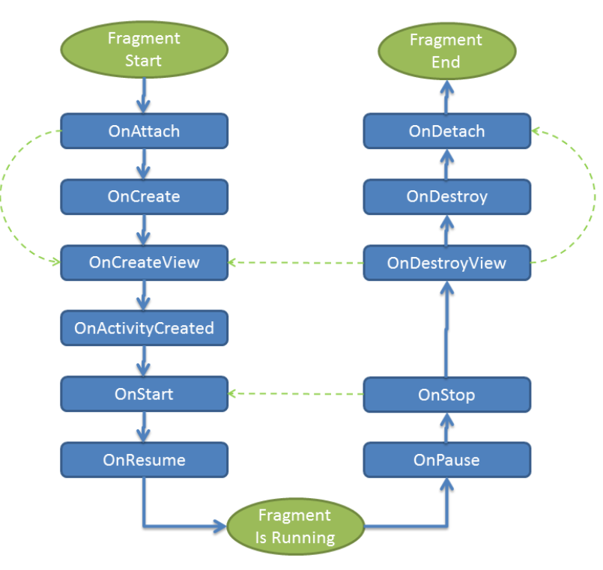
Fragment has its own lifecycle

Slide 8
Fragment – extend a Fragment class
via CODE: extend android.app.Fragment OR one of its subclasses (DialogFragment, ListFragment, PreferenceFragment, WebViewFragment )
IMPORTANT: must include a public empty constructor. The framework will often re-instantiate a fragment class when needed, in particular during state restore, and needs to be able to find this constructor to instantiate it. If the empty constructor is not available, a runtime exception will occur in some cases during state restore.
CALL Back functions (like Activity) : examples onCreate(), onStart(), onPause(), and onStop().

Slide 9
Fragment methods (callback functions)
onAttach(Activity) called once the fragment is associated with its activity.
onCreate(Bundle) called to do initial creation of the fragment.
onCreateView(LayoutInflater, ViewGroup, Bundle) creates and returns the view hierarchy associated with the fragment.
onActivityCreated(Bundle) tells the fragment that its activity has completed its own Activity.onCreaate.
onStart() makes the fragment visible to the user (based on its containing activity being started).
onResume() makes the fragment interacting with the user (based on its containing activity being resumed).

Slide 10
Fragment methods (callback functions)
As a fragment is no longer being used, it goes through a reverse series of callbacks:
onPause() fragment is no longer interacting with the user either because its activity is being paused or a fragment operation is modifying it in the activity.
onStop() fragment is no longer visible to the user either because its activity is being stopped or a fragment operation is modifying it in the activity.
onDestroyView() allows the fragment to clean up resources associated with its View.
onDestroy() called to do final cleanup of the fragment's state.
onDetach() called immediately prior to the fragment no longer being associated with its activity.

Slide 11
Fragments and their UI
Most fragments will have a UI
Will have its own layout
you must implement the onCreateView() callback method, which the Android system calls when it's time for the fragment to draw its layout. Your implementation of this method must return a View that is the root of your fragment's layout.

Slide 12
Fragments and their UI – onCreateView() using XML
Can implement onCreateView using XML
public static class ExampleFragment extends Fragment {
@Override
public View onCreateView(LayoutInflater inflater, ViewGroup container,
Bundle savedInstanceState) {
// Inflate the layout for this fragment
return inflater.inflate(R.layout.example_fragment, container, false);
}
}
Activity parent’s
ViewGroup
Bundle that provides data about the previous
instance of the fragment, if the fragment is being resumed
Have example_fragment.xml file that contains the layout
This will be contained in resource layout folder.

Slide 13
OPTION1 –adding to an Activity via Activity layout XML.
<?xml version="1.0" encoding="utf-8"?>
<LinearLayout xmlns:android="http://schemas.android.com/apk/res/android"
android:orientation="horizontal"
android:layout_width="match_parent"
android:layout_height="match_parent">
<fragment android:name="com.example.news.ArticleListFragment"
android:id="@+id/list"
android:layout_weight="1"
android:layout_width="0dp"
android:layout_height="match_parent" />
<fragment android:name="com.example.news.ArticleReaderFragment"
android:id="@+id/viewer"
android:layout_weight="2"
android:layout_width="0dp"
android:layout_height="match_parent" />
</LinearLayout>
2 fragment classes
Need unique ids for each so system can
restore the fragment if the activity is restarted

Slide 14
OPTION2 –creating and adding to an Activity via CODE.
/*Inside Activity Code where you want to add Fragment (dynamically anywhere or in onCreate() callback)
*/
//get FragmentTransaction associated with this Activity
FragmentManager fragmentManager = getFragmentManager();
FragmentTransaction fragmentTransaction = fragmentManager.beginTransaction();
//Create instance of your Fragment
ExampleFragment fragment = new ExampleFragment();
//Add Fragment instance to your Activity
fragmentTransaction.add(R.id.fragment_container, fragment);
fragmentTransaction.commit();
This points to the Activity ViewGroup in which the fragment should be placed, specified by resource ID

Slide 15
OPTION 3- Adding Fragment that has NO UI using Code
use a fragment to provide a background behavior for the activity without presenting additional UI.
use add(Fragment, String) (supplying a unique string "tag" for the fragment, rather than a view ID).
  it's not associated with a view in the activity layout, it does not receive a call to onCreateView(). So you don't need to implement that method.
If you want to get the fragment from the activity later, you need to use findFragmentByTag().
For an example activity that uses a fragment as a background worker, without a UI, see the FragmentRetainInstance.java sample.
STOP AND LOOK AT EXAMPLE ON OUR OUTLINE!!!!!!

Slide 16
Managing Fragments
FragmentManager methods:
Get fragments that exist in Activity =
  findFragmentById() (for fragments that provide a UI in the activity layout)
  findFragmentByTag() (for fragments that do or don't provide a UI).
Pop fragments off the back stack,
  popBackStack() (simulating a Back command by the user).
Register a listener for changes to the back stack,
  addOnBackStackChangedListener().

Slide 17
Fragment Transactions – adding, removing and replacing dynamically
// Create new fragment and transaction
Fragment newFragment = new ExampleFragment();
FragmentTransaction transaction getFragmentManager().beginTransaction();
// Replace whatever is in the fragment_container view with this fragment
// and add the transaction to the back stack
transaction.replace(R.id.fragment_container, newFragment);
transaction.addToBackStack(null);
// Commit the transaction
transaction.commit();
newFragment replaces whatever fragment (if any) is currently in the layout container identified by the R.id.fragment_container
If you do not call addToBackStack() when you perform a transaction
that removes a fragment, then that fragment is destroyed when the
transaction is committed and the user cannot navigate back to it.
Whereas, if you do call addToBackStack() when removing a fragment,
then the fragment is stopped and will be resumed if the user navigates back.

